Slide 1





DSA210 TERM PROJECT
FLASHCARD DATA ANALYSIS
ZEYNEP DILA KUYUCU - 32665

Slide 2



MOTIVATION
ı have long loved Language learnıng, and to understand my learnıng habıts, ı wanted to take a look at my flashcards app usage.
flashcards are cards that have the target word ın front and the translatıon at the back.
the languages ı study are german, korean and predomınantly, ıtalıan.

Slide 3


THE DATASET
I EXPORTED 3 DATASETS, ONE FOR EACH LANGUAGE, FROM THE APP AS CSV FILES. THEY CONTAIN THE WORD AND THE TRANSLATION.
THEN, THROUGH APPIUM SCRIPTS, I OBTAINED MY PROGRESS DATA. THIS DATA CONTAINS THE WORD, DATE IT WAS ADDED, NUMBER OF TIMES IT WAS STUDIED AND CORRECT AND INCORRECT ANSWERS IN THOSE STUDY SESSIONS.
AND THROUGH STANZA, I TAGGED THE PART OF SPEECH FOR EACH WORD.
AND THIS GAVE ME THE FULL DATASET.

Slide 4
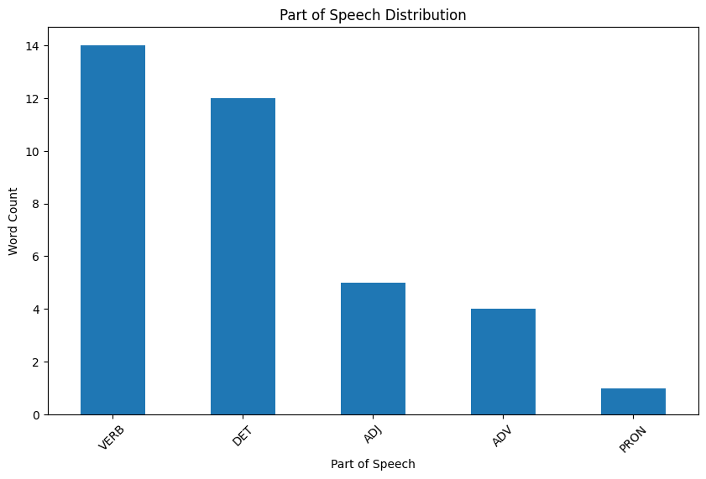
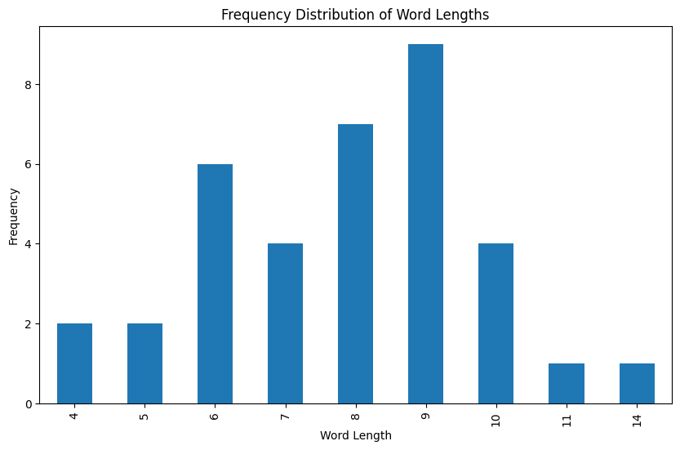


GENERAL OVERVIEW: GERMAN
TOTAL NUMBER OF WORDS: 36

Slide 5
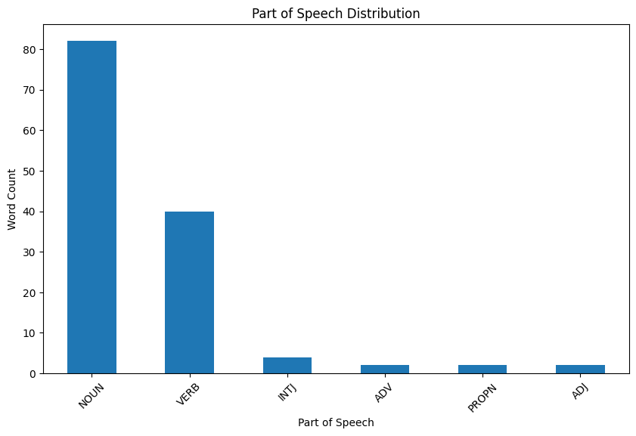
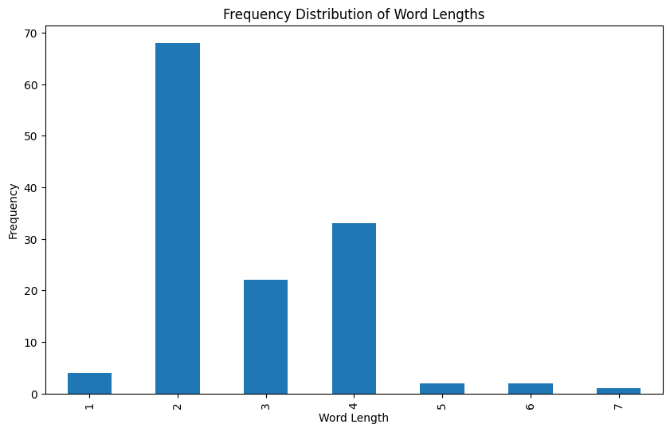
GENERAL OVERVIEW: KOREAN
TOTAL NUMBER OF WORDS: 132

Slide 6
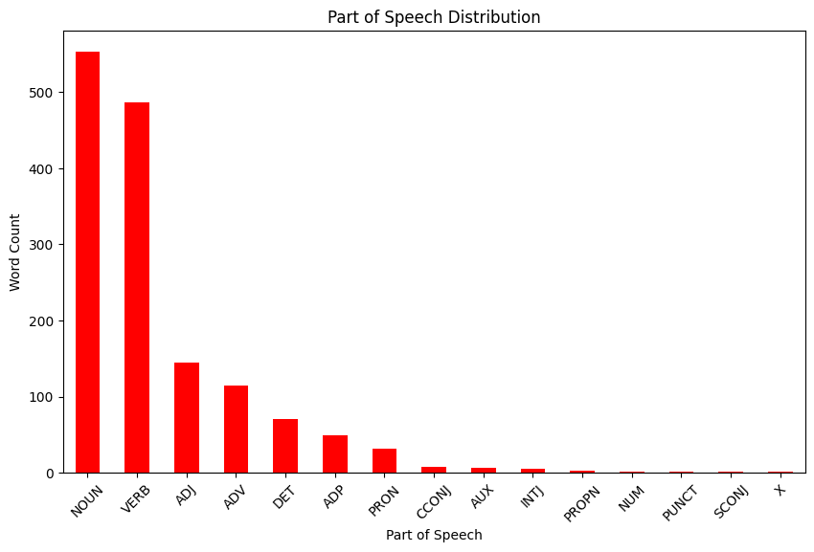
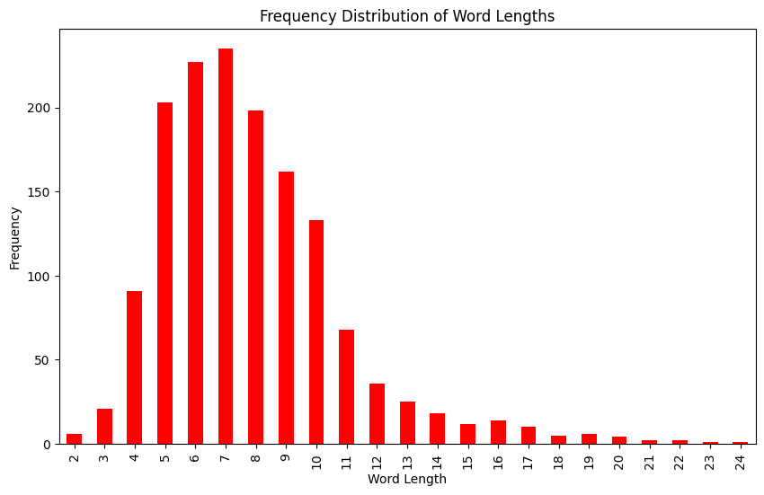
GENERAL OVERVIEW: ITALIAN
TOTAL NUMBER OF WORDS: 1480

Slide 7
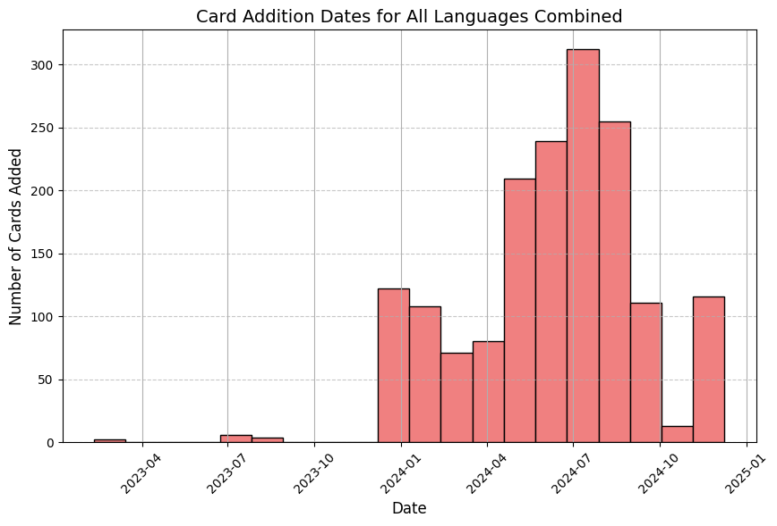
NEW CARD ADDITION DATES
THE MEAN NUMBER OF CARDS ADDED PER DAY IS AROUND 2.28, WITH A MAXIMUM OF 41 CARDS ADDED ON A SINGLE DAY.
THE DISTRIBUTION SHOWS MANY DAYS WITH ZERO NEW CARDS ADDED.
SPORADIC BURSTS OF ACTIVITY RATHER THAN A STEADY LEARNING TREND.

Slide 8
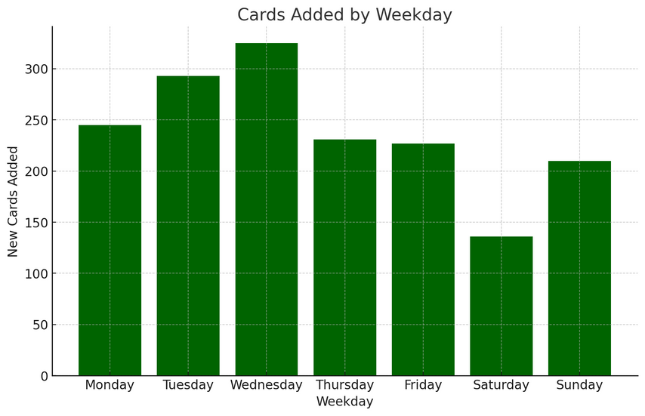
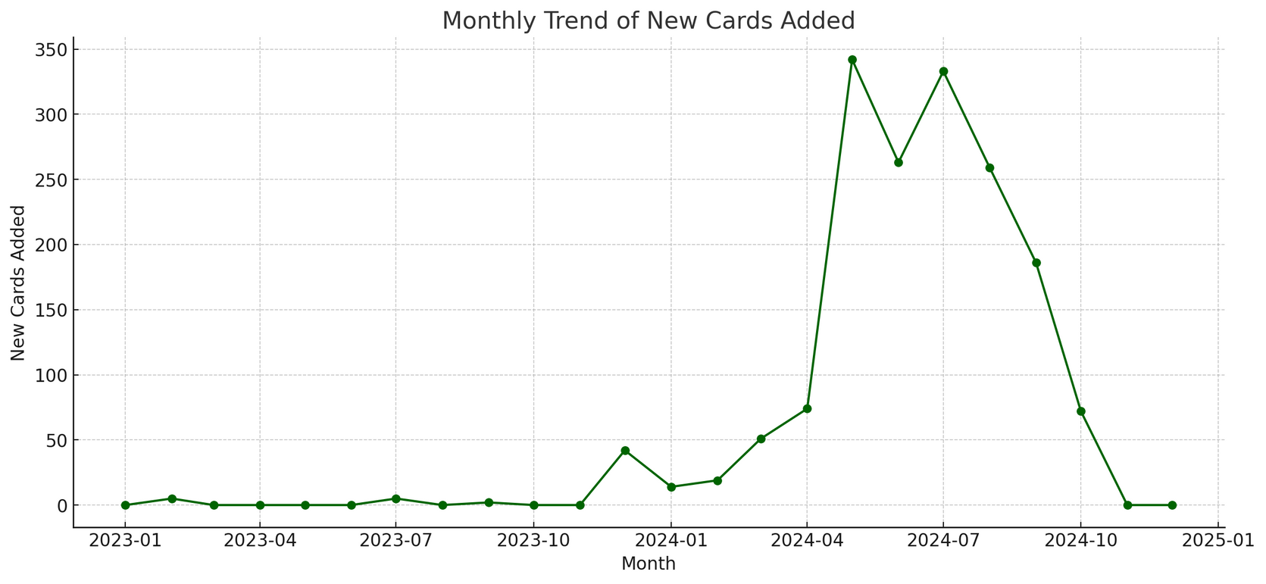
NEW CARD ADDITION DATES
DAYS WITH ACTIVITY: 133 DAYS
DAYS WITHOUT ACTIVITY: 598 DAYS
PRODUCTIVITY RATE: 18.19% (PERCENTAGE OF DAYS WITH ACTIVITY)
PEAK ACTIVITY DAY: MAY 20, 2024
PEAK ACTIVITY VALUE: 41 CARDS ADDED IN A SINGLE DAY

Slide 9
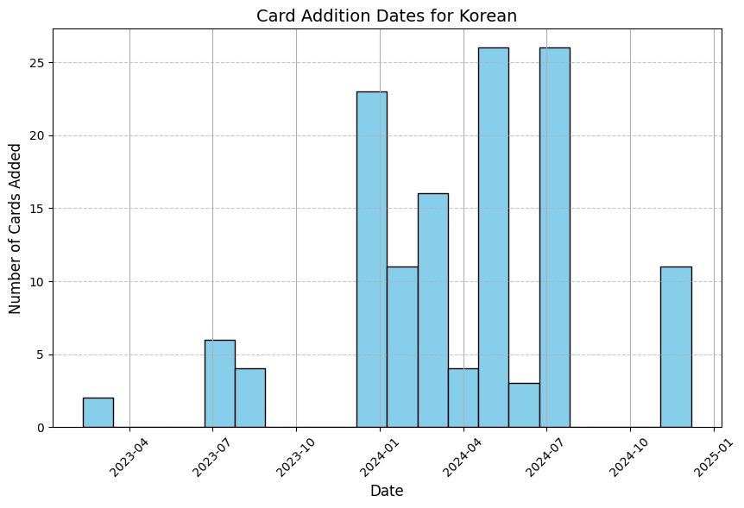
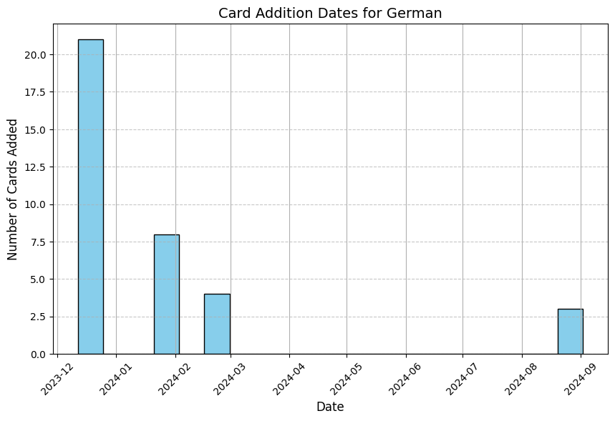
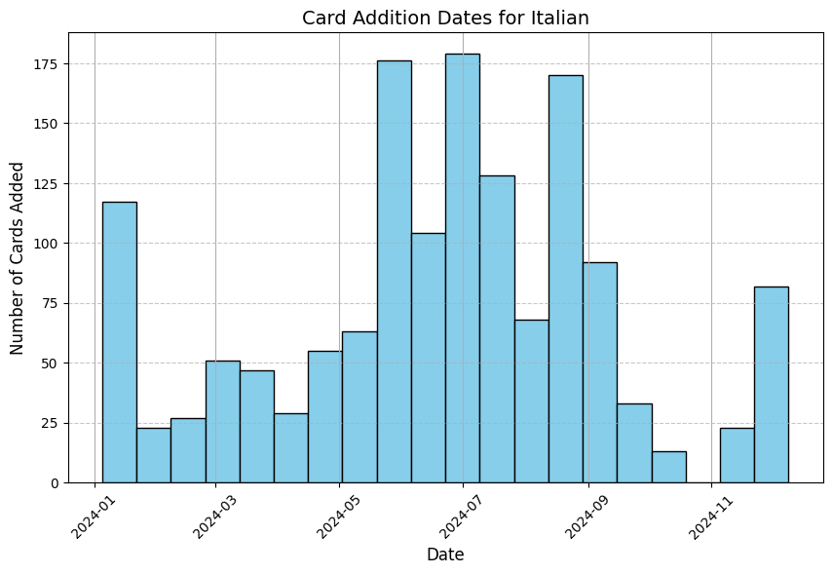
NEW CARD ADDITION DATES (PER LANGUAGE)

Slide 10
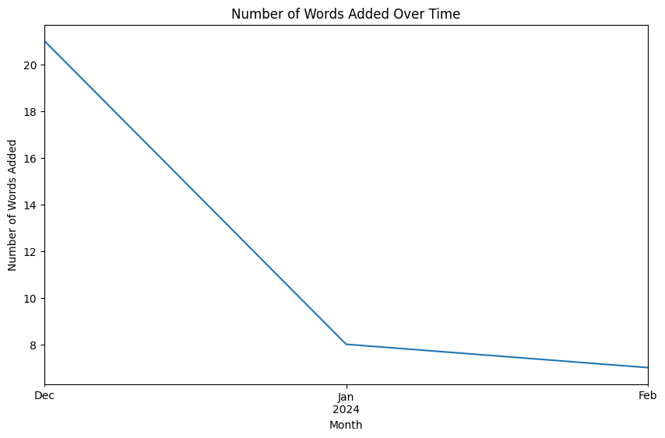
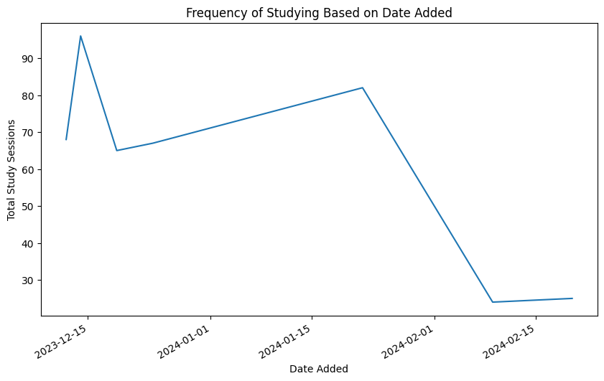
DESCRIPTIVE ANALYSIS: GERMAN
COUNT MEAN STD MIN 25% 50% 75% MAX
STUDIED 36.0 11.861111 3.473597 6.0 10.0 11.5 16.0 17.0
CORRECT ANSWERS 36.0 11.333333 3.656696 6.0 9.0 11.0 15.0 17.0
INCORRECT ANSWERS 36.0 0.527778 0.696362 0.0 0.0 0.0 1.0 3.0

Slide 11
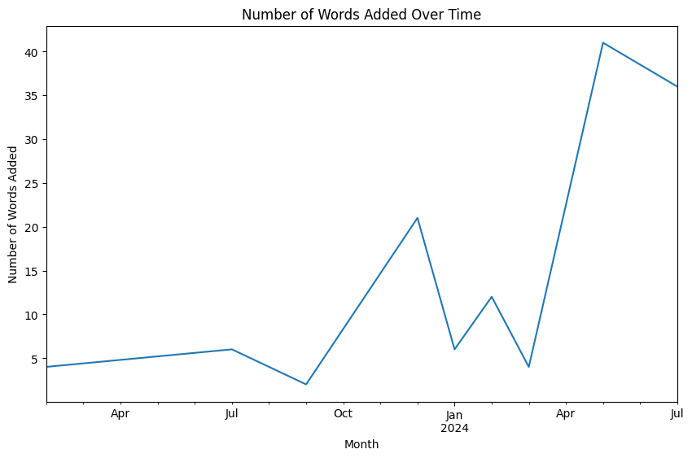
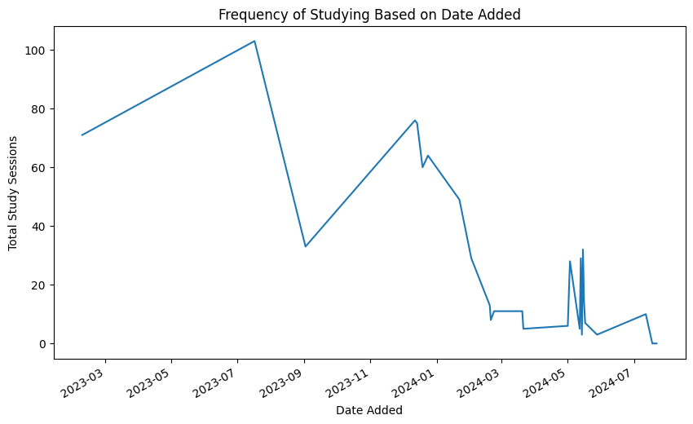
DESCRIPTIVE ANALYSIS: KOREAN
COUNT MEAN STD MIN 25% 50% 75% MAX
STUDIED 132.0 5.643939 5.717434 0.0 1.0 3.0 9.25 18.0
CORRECT ANSWERS 106.0 6.566038 5.753705 0.0 2.0 3.0 11.75 18.0
INCORRECT ANSWERS 106.0 0.462264 0.794919 0.0 0.0 0.0 1.00 4.0

Slide 12
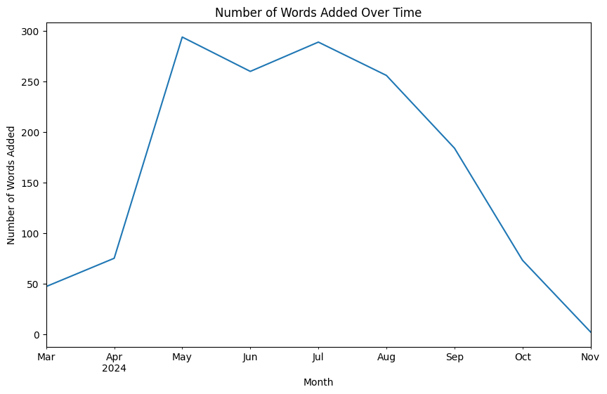
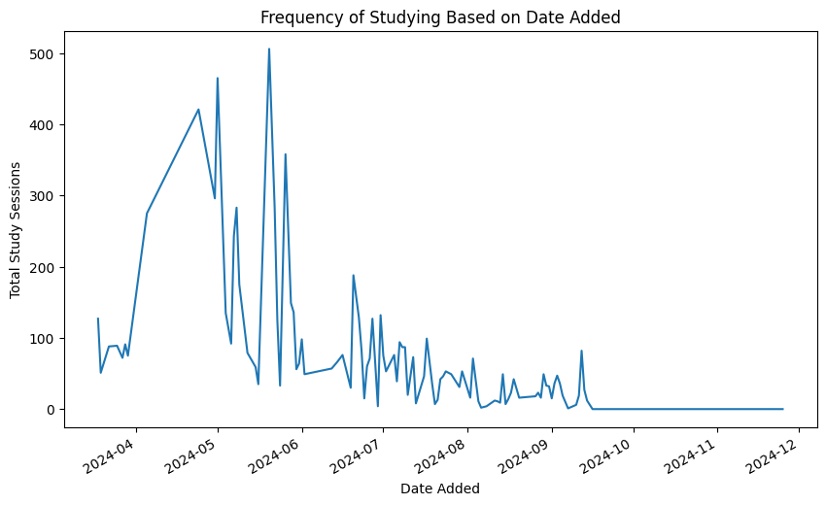
DESCRIPTIVE ANALYSIS: ITALIAN
COUNT MEAN STD MIN 25% 50% 75% MAX
STUDIED 1480.0 5.375676 4.430908 0.0 2.0 4.0 9.0 20.0
CORRECT ANSWERS 1371.0 5.045222 4.256485 0.0 1.0 3.0 10.0 20.0
INCORRECT ANSWERS 1371.0 0.757841 1.031477 0.0 0.0 0.0 1.0 6.0

Slide 13
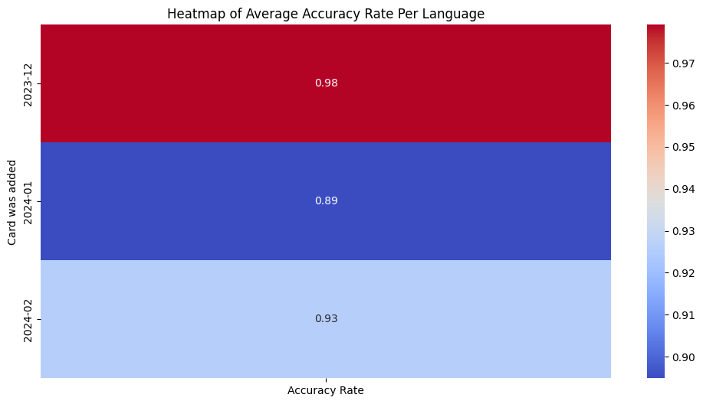
ACCURACY ANALYSIS: GERMAN
AVERAGE ACCURACY RATE PER LANGUAGE:
CARD WAS ADDED
2023-12 0.979090
2024-01 0.894886
2024-02 0.926020

Slide 14
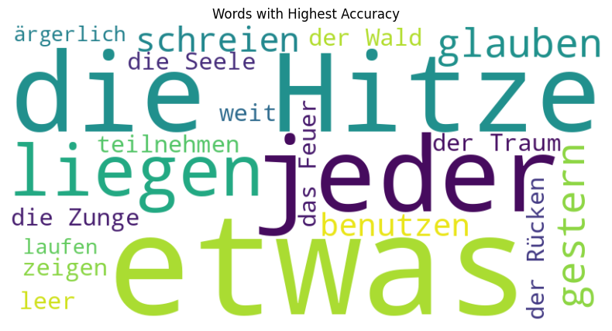
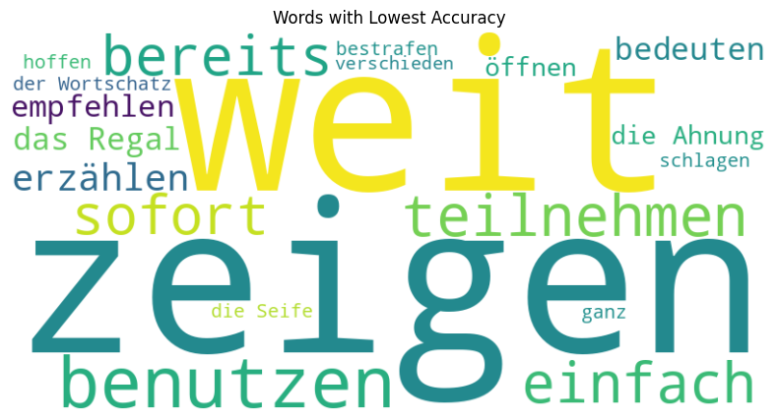

Slide 15
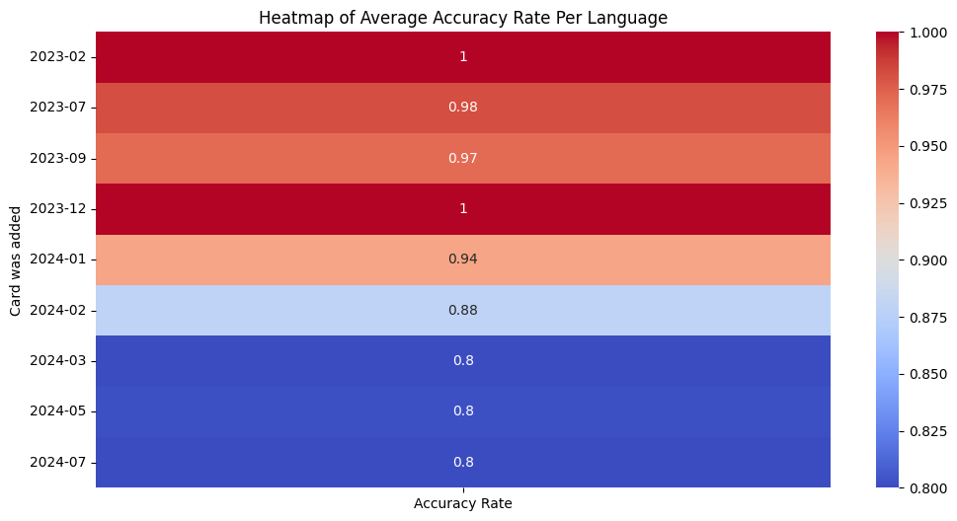
ACCURACY ANALYSIS: KOREAN
AVERAGE ACCURACY RATE PER LANGUAGE:
CARD WAS ADDED
2023-02 1.000000
2023-07 0.981481
2023-09 0.970588
2023-12 1.000000
2024-01 0.944444
2024-02 0.879365
2024-03 0.800000
2024-05 0.801626
2024-07 0.800000

Slide 16
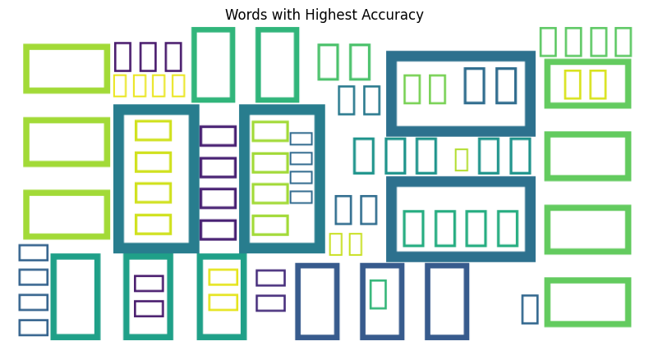
UNFORTUNATELY, PYTHON COULDNT HANDLE KOREAN CHARACTERS FOR THE WORD CLOUD...

Slide 17
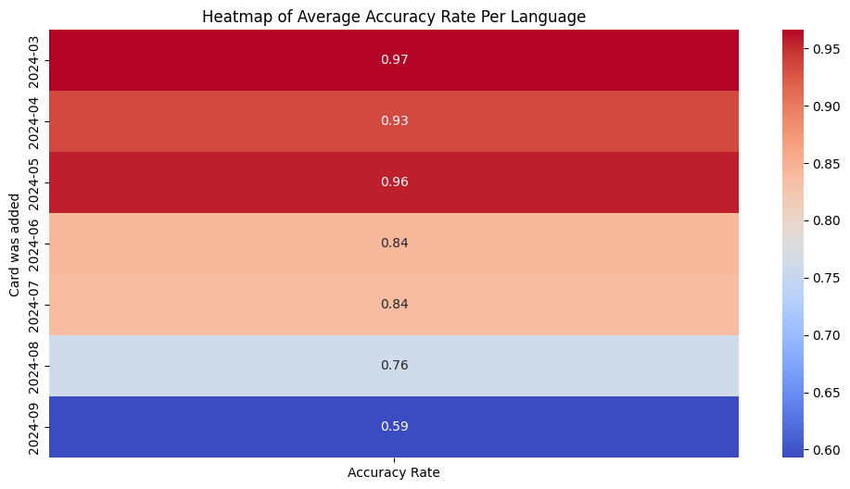
ACCURACY ANALYSIS: ITALIAN
AVERAGE ACCURACY RATE PER LANGUAGE:
CARD WAS ADDED
2024-03 0.966065
2024-04 0.934804
2024-05 0.957225
2024-06 0.840888
2024-07 0.837432
2024-08 0.761458
2024-09 0.592889

Slide 18
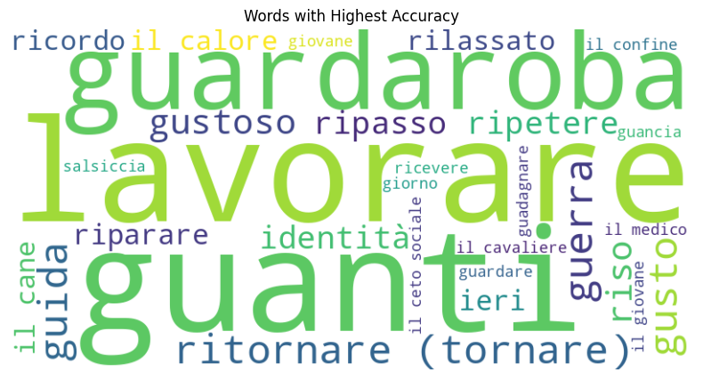
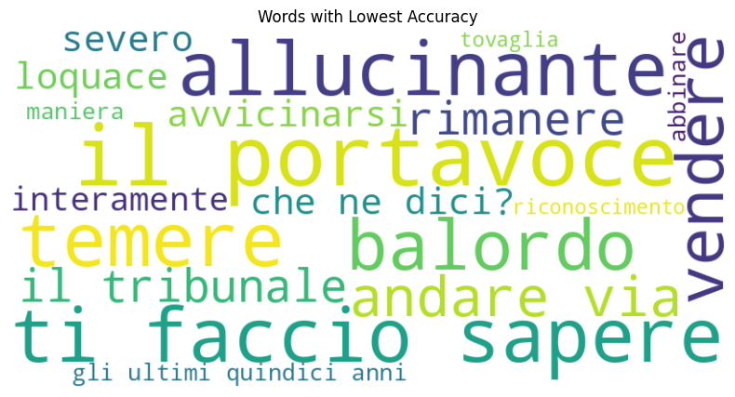

Slide 19
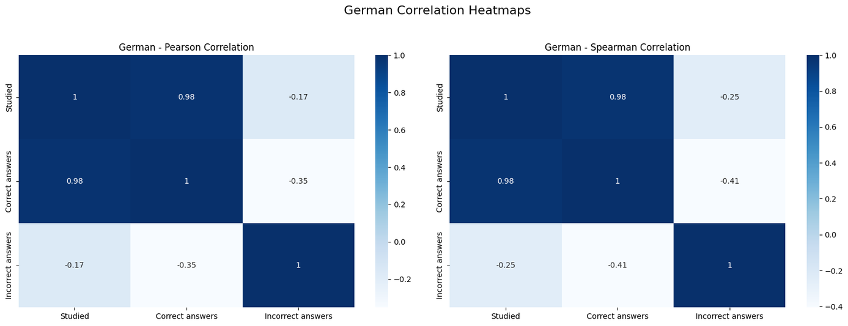
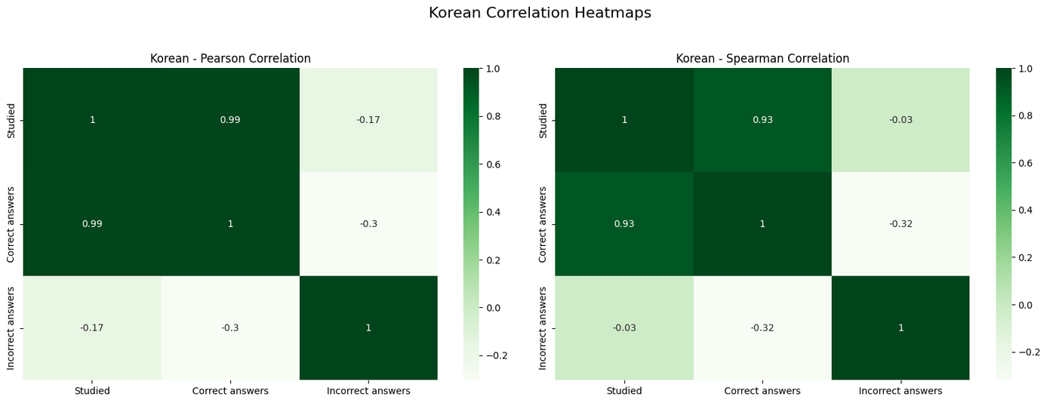
correlatıons

Slide 20
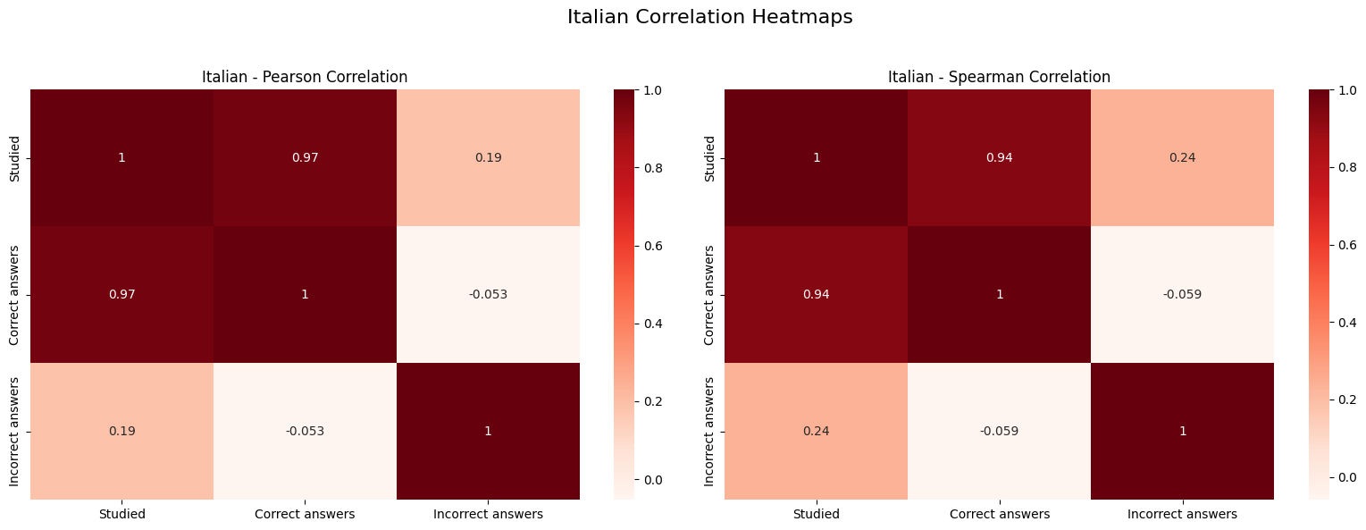

Slide 21

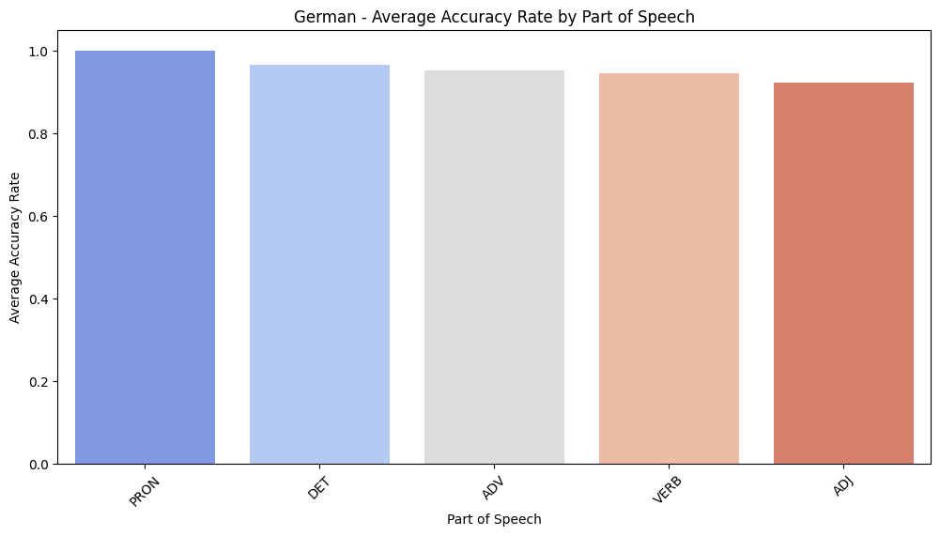
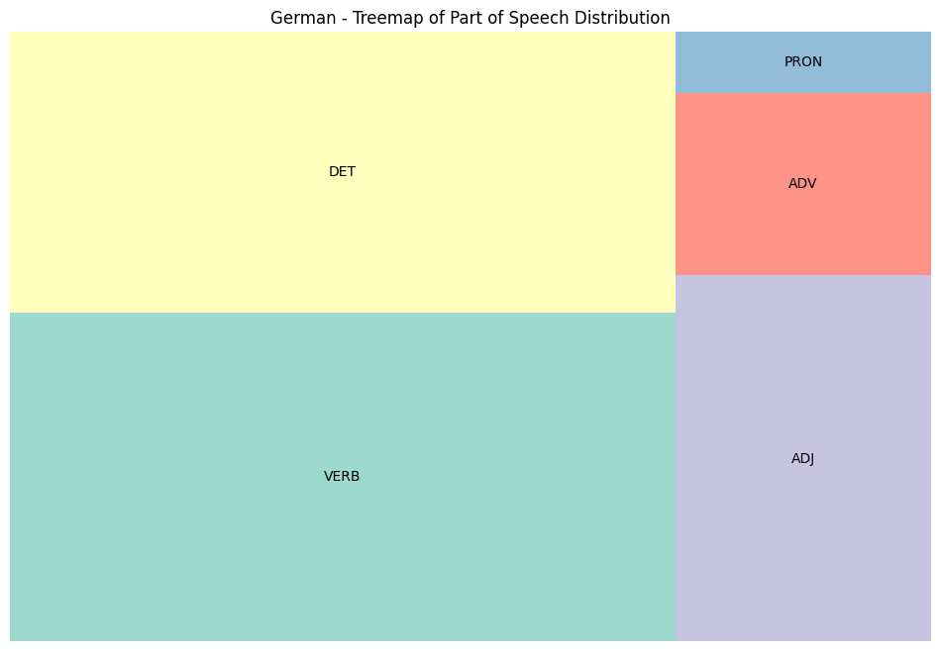

parts of speech analysis
AVERAGE PERFORMANCE BY PART OF SPEECH:
PART OF SPEECH
PRON 1.000000
DET 0.965341
ADV 0.953526
VERB 0.944558
ADJ 0.922276

Slide 22
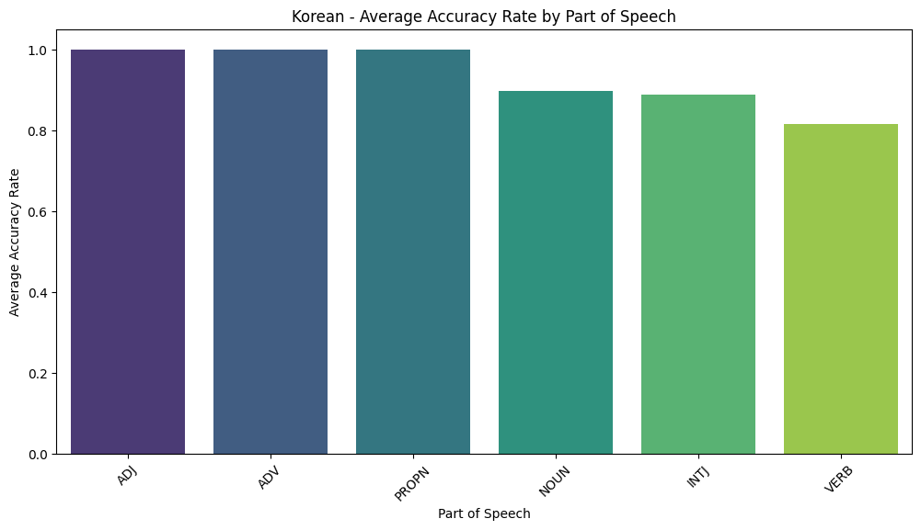
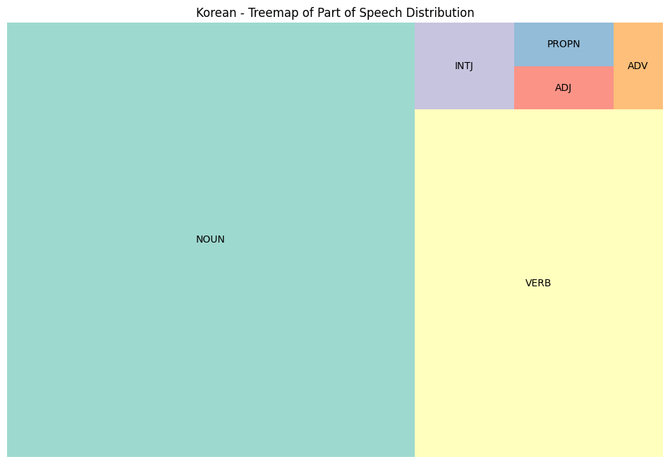
parts of speech analysis
AVERAGE PERFORMANCE BY PART OF SPEECH:
PART OF SPEECH
ADJ 1.000000
ADV 1.000000
PROPN 1.000000
NOUN 0.898870
INTJ 0.888889
VERB 0.815801

Slide 23
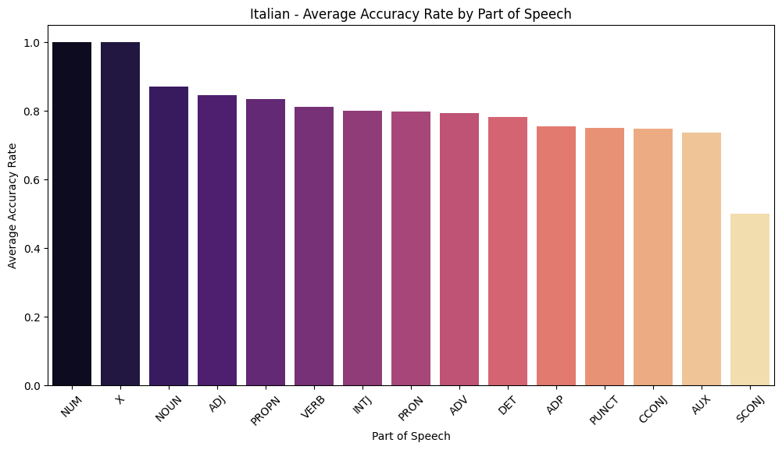
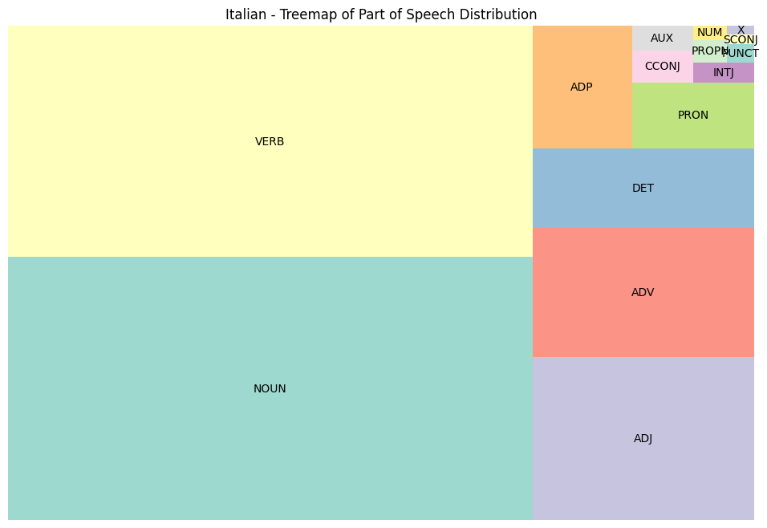
parts of speech analysis
Average Performance by Part of Speech:
Part of Speech
NUM 1.000000
X 1.000000
NOUN 0.870091
ADJ 0.845839
PROPN 0.833333
VERB 0.812832
INTJ 0.800000
PRON 0.797513
ADV 0.792719
DET 0.782599
ADP 0.755613
PUNCT 0.750000
CCONJ 0.747619
AUX 0.736111
SCONJ 0.500000

Slide 24
comparıng the 3 languages
General Descriptive Statistics Across All Languages:
Correct answers Incorrect answers Studied
count 1513.00 1513.00 1648.00
mean 5.30 0.73 5.54
std 4.48 1.01 4.62
min 0.00 0.00 0.00
25% 1.00 0.00 2.00
50% 3.00 0.00 4.00
75% 10.00 1.00 10.00
max 20.00 6.00 20.00

Slide 25
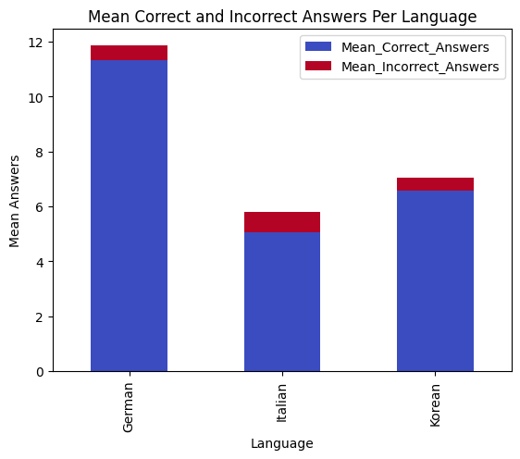
comparıng the 3 languages

Slide 26
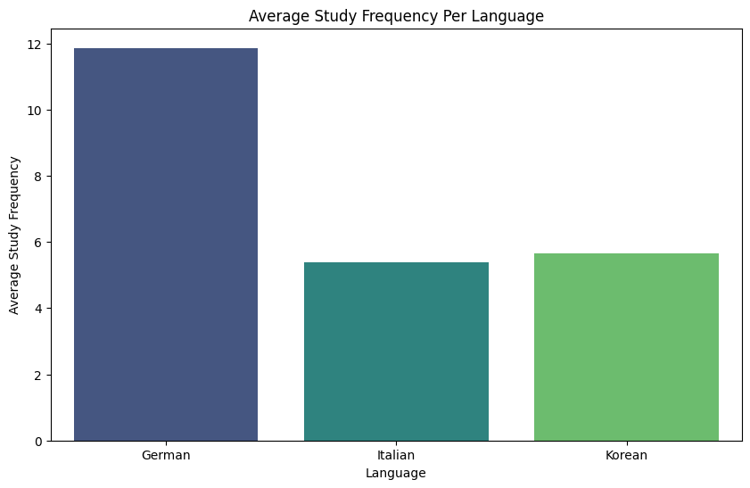
comparıng the 3 languages

Slide 27
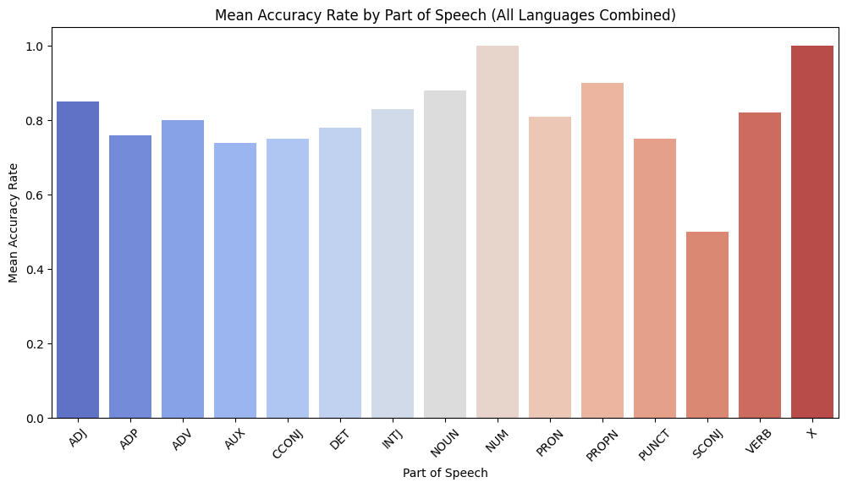
comparıng the 3 languages

